Slide 1

Web Engineering
Introduction to HTML

Slide 2
HTML
HTML stands for Hypertext Markup Language.
It is the standard markup language for creating web pages.
HTML uses a system of markup tags enclosed in angle brackets (< >).
Tags are used to define the structure and content of a web page.

Slide 3
Basic Structure
<!DOCTYPE html> <html> <head> <title>Page Title</title> </head> <body> <h1>This is a Heading</h1> <p>This is a paragraph.</p> </body> </html>

Slide 4
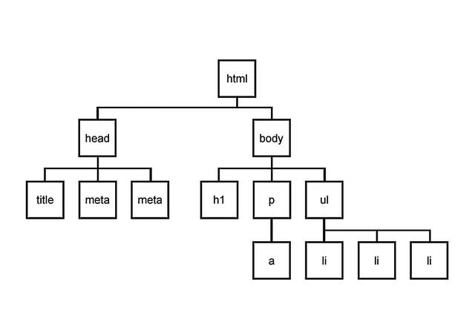
Basic Structure

Slide 5
Key HTML Tags
<html>: The root element that wraps the entire web page.
<head>: Contains meta-information about the document.
<title>: Sets the title displayed in the browser tab.
<body>: Contains the visible content of the web page.

Slide 6
HTML elements and HTML tags
HTML elements and HTML tags are often confused.
The tags are used to open and close the object, whereas the element includes both tags and its content.
Let’s consider an example with the <h1> tag:
<h1> Title of the document </h1> - is an element,
and <h1>, </h1> - are tags.

Slide 7
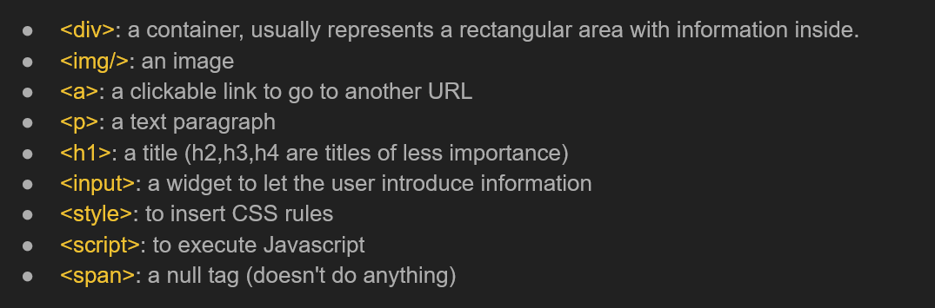
More HTML Tags
A few most important HTML tags are listed below:

Slide 8
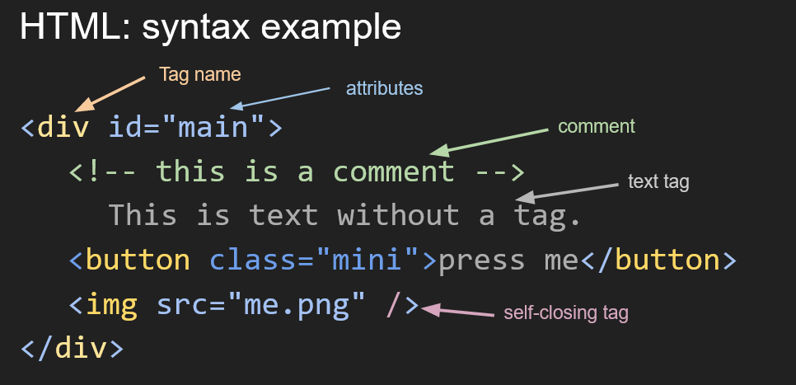
HTML Syntax Example

Slide 9
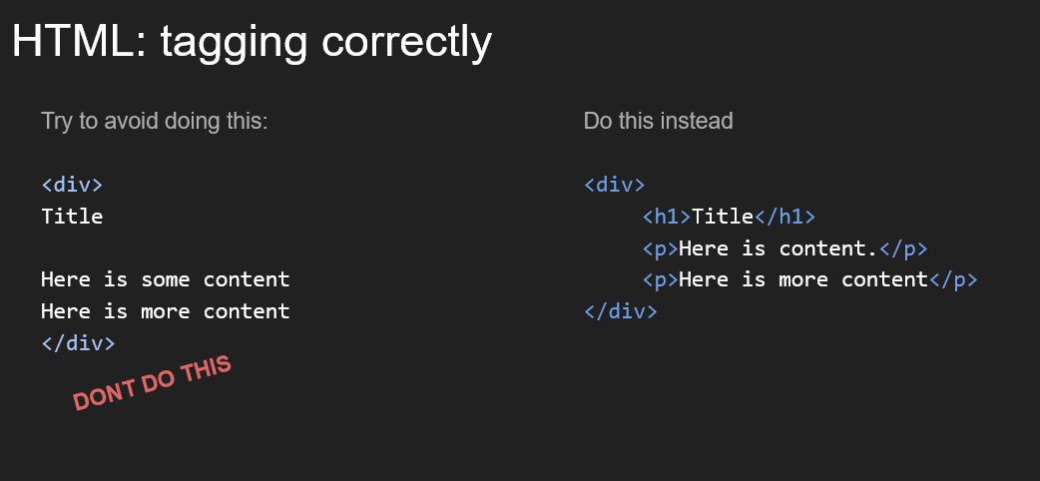
HTML: Tagging correctly

Slide 10
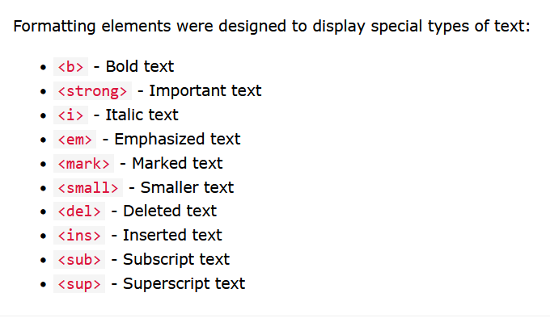
HTML Formatting Elements

Slide 11
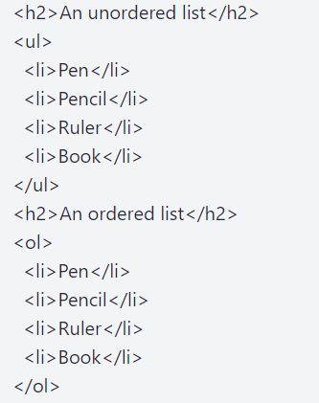
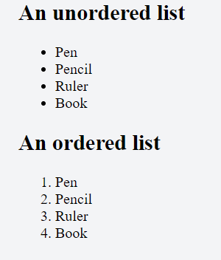
HTML Lists
HTML lists are specified with the <ul> tag that is used for specifying an unordered list, or with the <ol> tag that is used to create an ordered list, followed by <li> tags.

Slide 12
HTML Horizontal Lines
The HTML <hr> tag breaks the page into different parts and with the help of a horizontal line, which runs from left to right edge of the page, creates horizontal margins. This is an empty tag.

Slide 13
HTML Attributes
HTML attributes are used within the opening tag. They provide additional information about HTML elements. An attribute edits the default functionality of an element or offers functionality to specific element types that cannot function properly without them. The attribute has a name, followed by the equals sign(=) and a value placed inside the quotation marks("").
Syntax
<tag attribute="value">Your Text</tag>

Slide 14
HTML Link
The href Attribute
The <a> tag defines a hyperlink. The href attribute specifies the URL of the page the link goes to:
Example
<a href="https://www.w3schools.com">Visit W3Schools</a>

Slide 15
HTML Image
HTML <img /> tag with the src, width, height, alt and style attributes

Slide 16
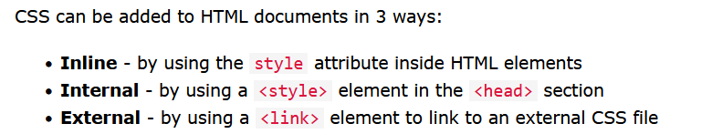
HTML CSS
Cascading Style Sheets (CSS) is used to format the layout of a webpage.

Slide 17
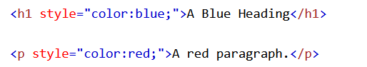
Inline CSS
<h1 style="background-color:powderblue;">This is a heading</h1>
<p style="background-color:tomato;">This is a paragraph.</p>

Slide 18
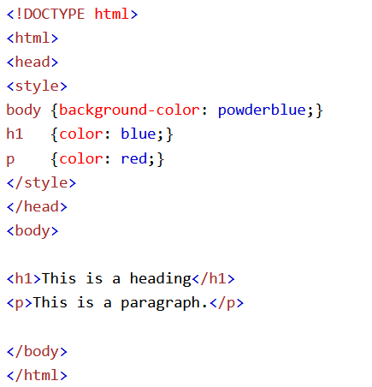
Internal CSS

Slide 19
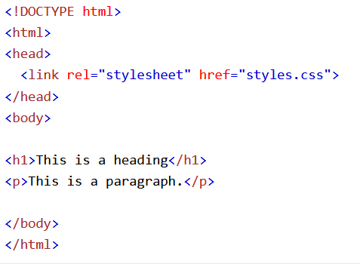
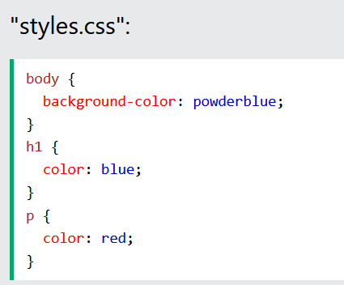
External CSS

Slide 20


